Slide 1
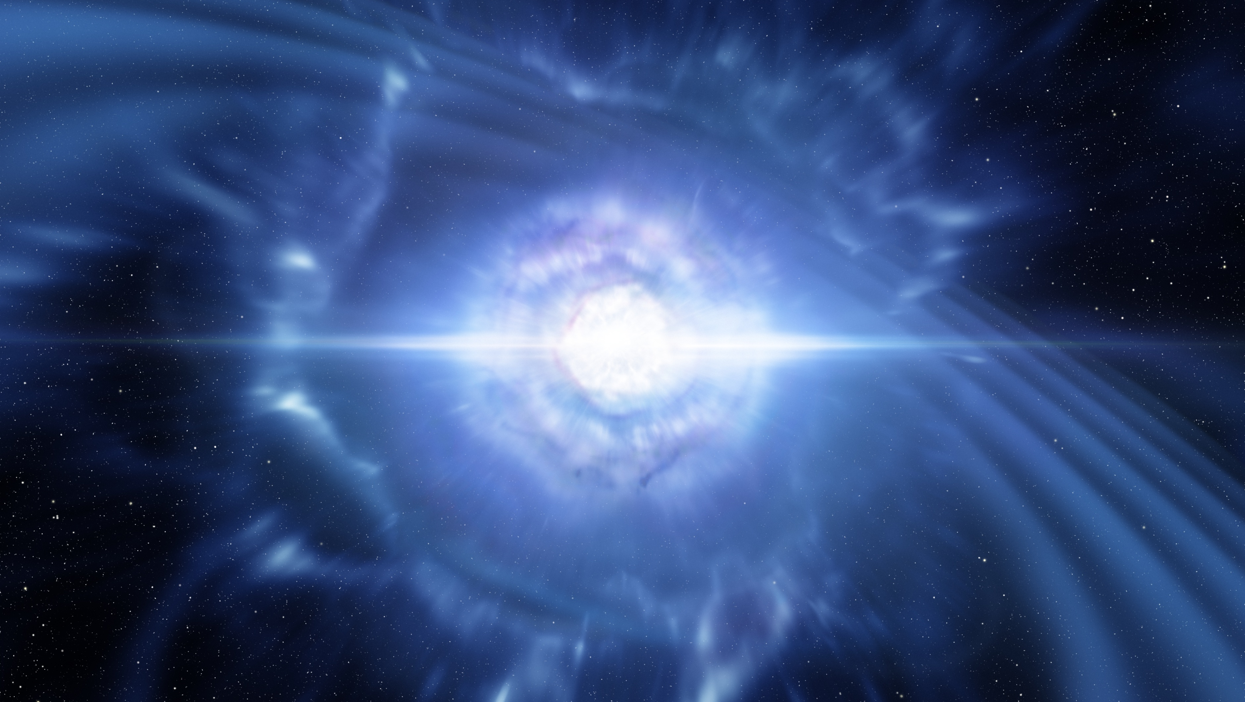
Neutron Stars in General Relativity
Gravitation Seminars - 11/12/2025
Diego García Tejada

Slide 2
Contents
Introduction
Equations of Stellar Structure
Equations of State (EoS)
Solutions to the TOV equation
Conclusions

Slide 3
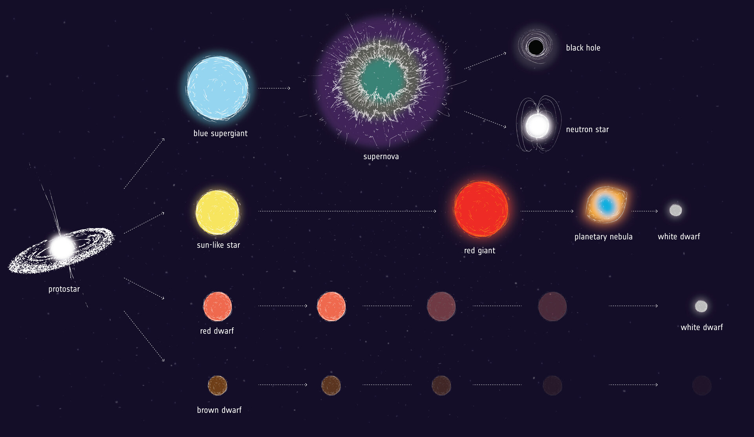
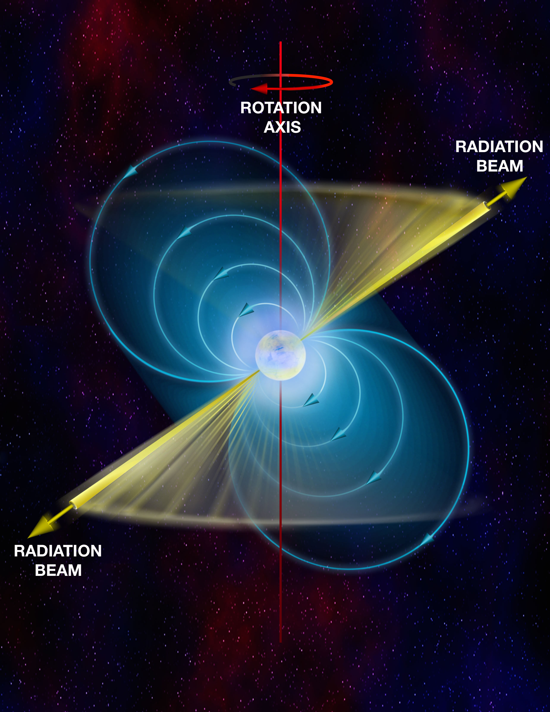
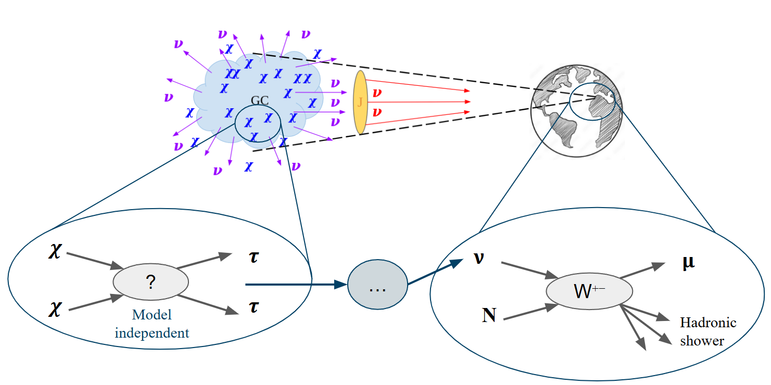
Introduction to Neutron Stars
What are neutron stars?
Compact objects that remain after the death of a supermassive star.
Why are they interesting?
They are testing grounds for both GR and QM.
How where they discovered?
First proposed in 1934, first observed in 1968.
Why are they interesting?
The high densities provide laboratories for high density nuclear physics.
Uncertainty in EoS -> Uncertainty in the structure.
Origin of heavy elements in NS collisions?
Test of dark matter?

Slide 4
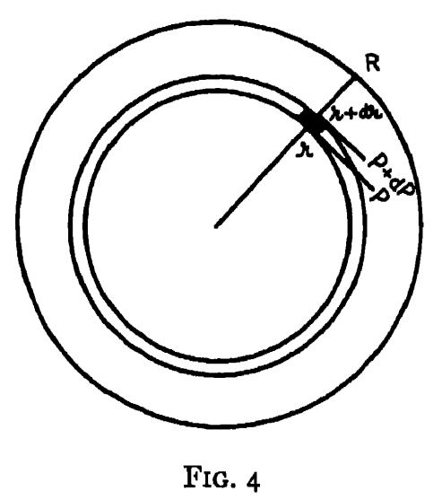
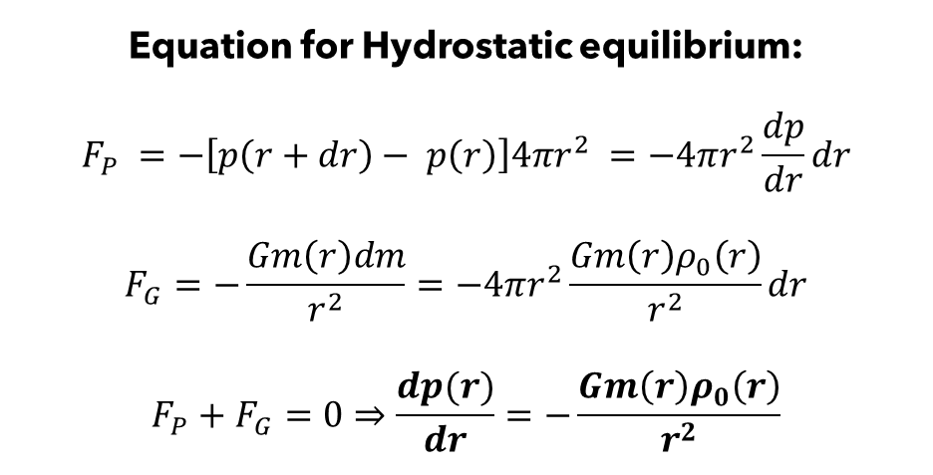
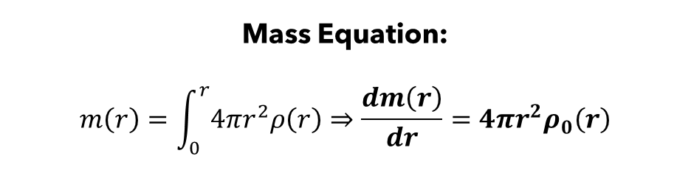
Stellar Structure: Newtonian Gravity
Mass Equation:
$$m\left(r\right)=\int_{0}^{r}{4πr^{2}ρ\left(r\right)}⇒\frac{dm\left(r\right)}{dr}=4πr^{2}ρ_{0}\left(r\right)$$
Equation for Hydrostatic equilibrium:
$$F_{P} =−\left[p\left(r+dr\right)− p\left(r\right)\right]4πr^{2} =−4πr^{2}\frac{dp}{dr}dr$$
$$F_{G}=−\frac{Gm\left(r\right)dm}{r^{2}}=−4πr^{2}\frac{Gm\left(r\right)ρ_{0}\left(r\right)}{r^{2}}dr$$
$$F_{P}+F_{G}=0⇒\frac{dp(r)}{dr}=−\frac{Gm\left(r\right)ρ_{0}\left(r\right)}{r^{2}}$$

Slide 5
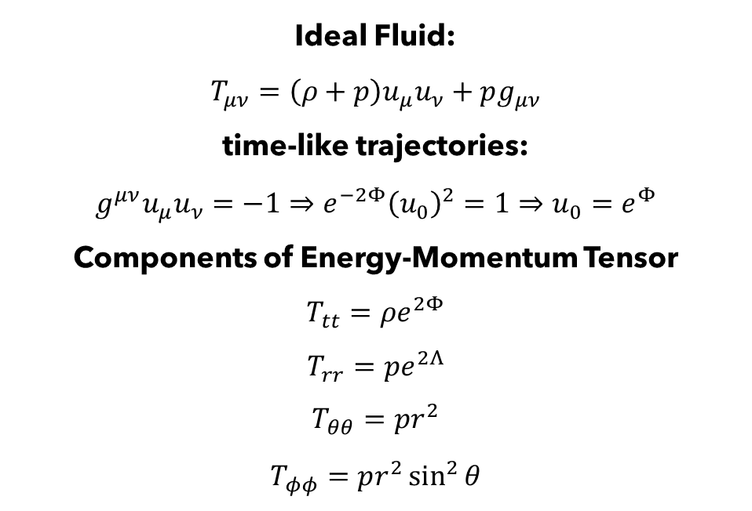
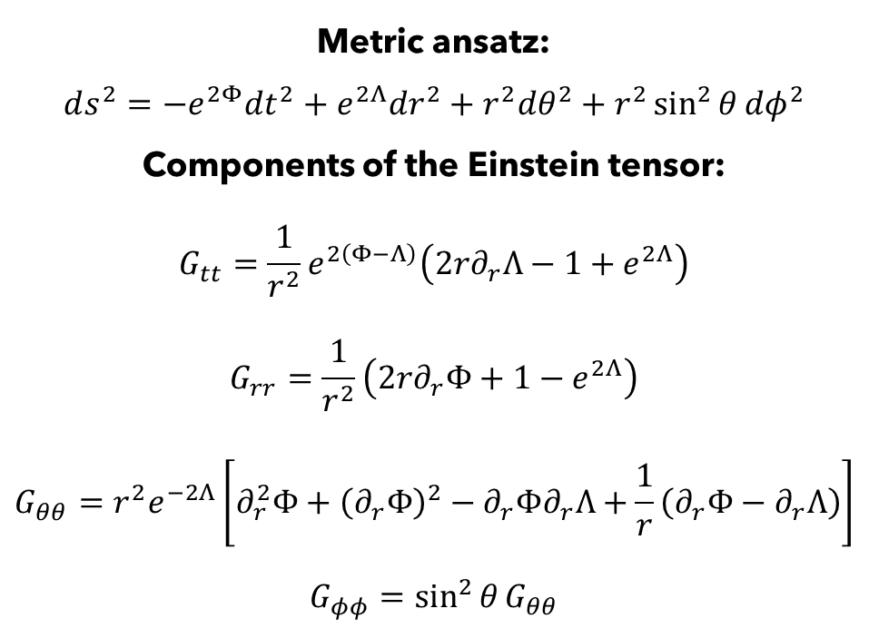
Stellar Structure: GR
Metric ansatz:
$$ds^{2}=−e^{2Φ}dt^{2}+e^{2Λ}dr^{2}+r^{2}dθ^{2}+r^{2}\sin^{2}{θ}dφ^{2}$$
Components of the Einstein tensor:
$$G_{tt}=\frac{1}{r^{2}}e^{2\left(Φ−Λ\right)}\left(2r∂_{r}Λ−1+e^{2Λ}\right)$$
$$G_{rr}=\frac{1}{r^{2}}\left(2r∂_{r}Φ+1−e^{2Λ}\right)$$
$$G_{θθ}=r^{2}e^{−2Λ}\left[∂_{r}^{2}Φ+{\left(∂_{r}Φ\right)}^{2}−∂_{r}Φ∂_{r}Λ+\frac{1}{r}\left(∂_{r}Φ−∂_{r}Λ\right)\right]$$
$$G_{φφ}=\sin^{2}{θ}G_{θθ}$$
Ideal Fluid:
$$T_{μν}=\left(ρ+p\right)u_{μ}u_{ν}+pg_{μν}$$
time-like trajectories:
$$g^{μν}u_{μ}u_{ν}=−1⇒e^{−2Φ}{\left(u_{0}\right)}^{2}=1⇒u_{0}=e^{Φ}$$
Components of Energy-Momentum Tensor
$$T_{tt}=ρe^{2Φ}$$
$$T_{rr}=pe^{2Λ}$$
$$T_{θθ}=pr^{2}$$
$$T_{φφ}=pr^{2}\sin^{2}{θ}$$

Slide 6
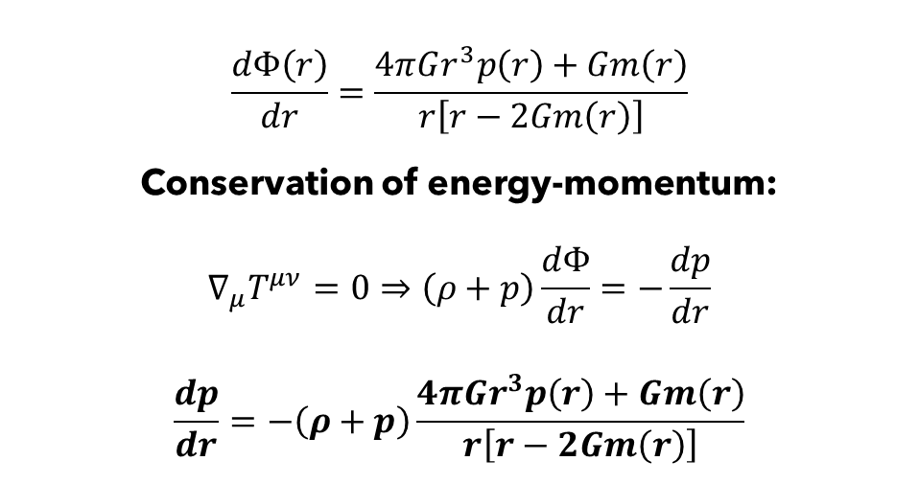
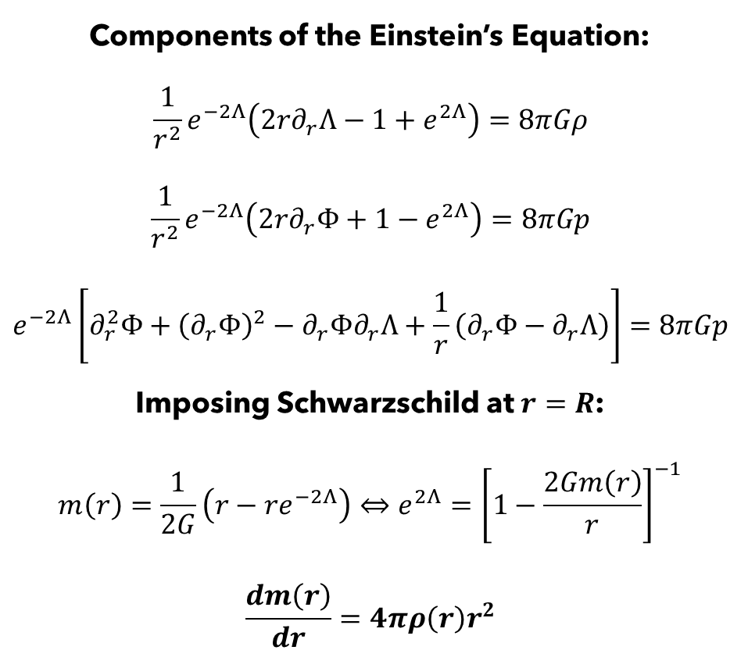
Stellar Structure: GR
Components of the Einstein’s Equation:
$$\frac{1}{r^{2}}e^{−2Λ}\left(2r∂_{r}Λ−1+e^{2Λ}\right)=8πGρ$$
$$\frac{1}{r^{2}}e^{−2Λ}\left(2r∂_{r}Φ+1−e^{2Λ}\right)=8πGp$$
$$e^{−2Λ}\left[∂_{r}^{2}Φ+{\left(∂_{r}Φ\right)}^{2}−∂_{r}Φ∂_{r}Λ+\frac{1}{r}\left(∂_{r}Φ−∂_{r}Λ\right)\right]=8πGp$$
Imposing Schwarzschild at $r=R$:
$$m\left(r\right)=\frac{1}{2G}\left(r−re^{−2Λ}\right)⇔e^{2Λ}={\left[1−\frac{2Gm\left(r\right)}{r}\right]}^{−1}$$
$$\frac{dm\left(r\right)}{dr}=4πρ\left(r\right)r^{2}$$
$$\frac{dΦ\left(r\right)}{dr}=\frac{4πGr^{3}p\left(r\right)+Gm\left(r\right)}{r\left[r−2Gm\left(r\right)\right]}$$
Conservation of energy-momentum:
$$∇_{μ}T^{μν}=0⇒\left(ρ+p\right)\frac{dΦ}{dr}=−\frac{dp}{dr}$$
$$\frac{dp}{dr}=−\left(ρ+p\right)\frac{4πGr^{3}p\left(r\right)+Gm\left(r\right)}{r\left[r−2Gm\left(r\right)\right]}$$
Tolman-Oppenheimer-Volkoff equation
Mass equation

Slide 7
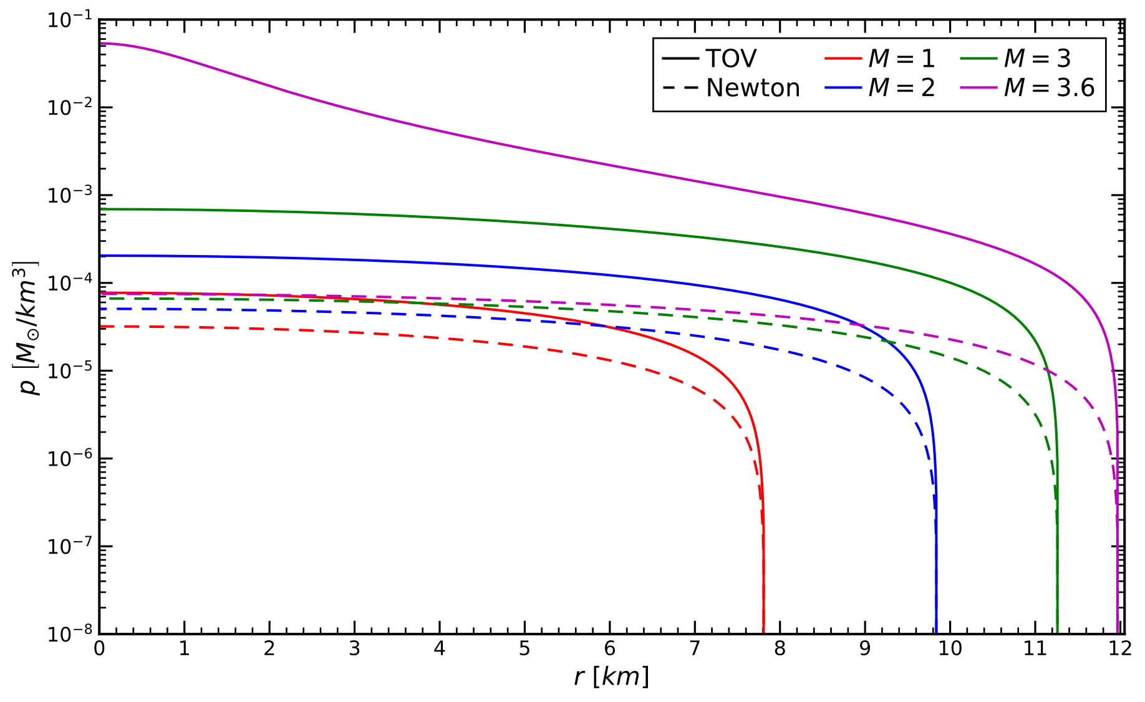
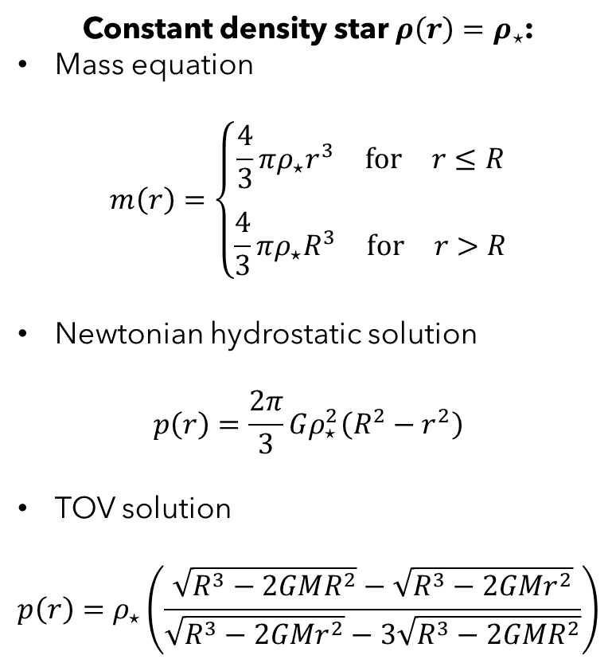
Newtonian Gravity vs GR
Constant density star $ρ\left(r\right)=ρ_{⋆}$:
Mass equation
$$m\left(r\right)=\left\{\begin{matrix}\frac{4}{3}πρ_{⋆}r^{3} \text{for} r≤R \\ \\ \frac{4}{3}πρ_{⋆}R^{3} \text{for} r>R\end{matrix}\right.$$
Newtonian hydrostatic solution
$$p\left(r\right)=\frac{2π}{3}Gρ_{⋆}^{2}\left(R^{2}−r^{2}\right)$$
TOV solution
$$p\left(r\right)=ρ_{⋆}\left(\frac{\sqrt{R^{3}−2GMR^{2}}−\sqrt{R^{3}−2GMr^{2}}}{\sqrt{R^{3}−2GMr^{2}}−3\sqrt{R^{3}−2GMR^{2}}}\right)$$

Slide 8
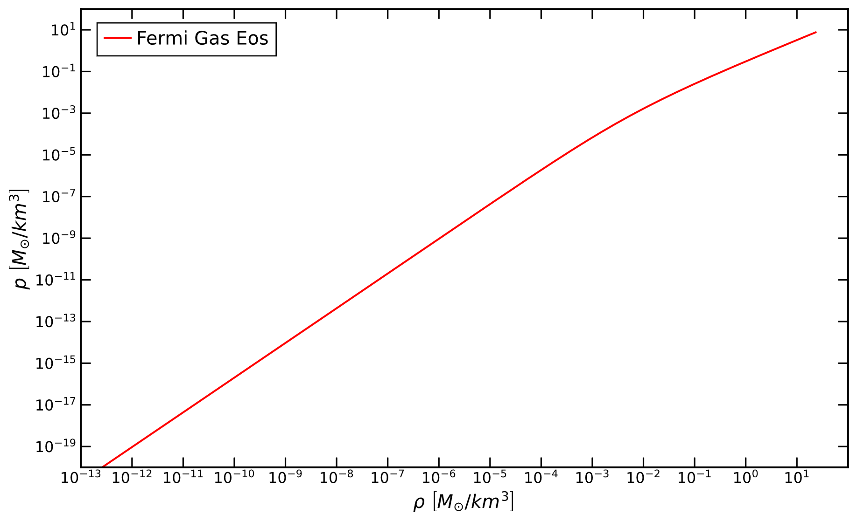
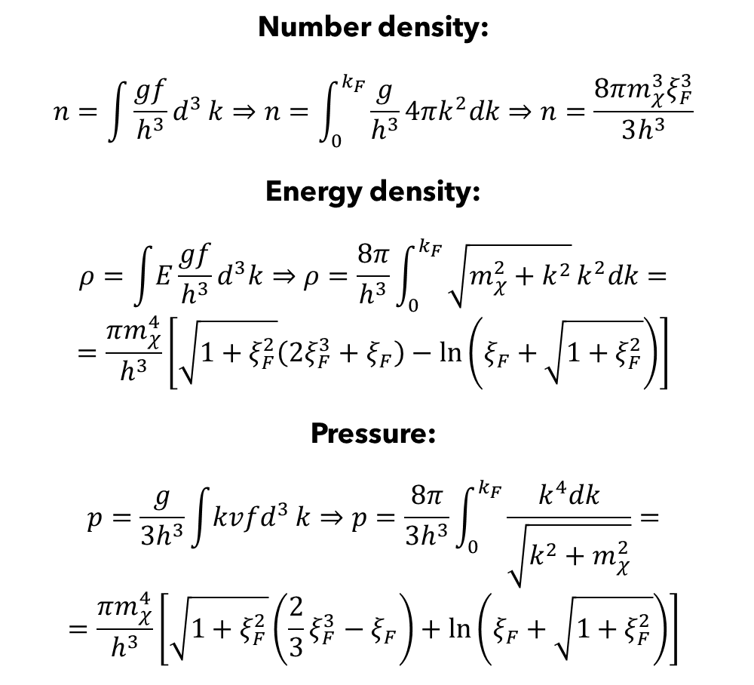
Equations of state: Free Fermi Gas
Number density:
$$n=\int{\frac{gf}{h^{3}}d^{3}}k⇒n=\int_{0}^{k_{F}}{\frac{g}{h^{3}}}4πk^{2}dk⇒n=\frac{8πm_{χ}^{3}ξ_{F}^{3}}{3h^{3}}$$
Energy density:
$$ρ=\int{E}\frac{gf}{h^{3}}d^{3}k⇒ρ=\frac{8π}{h^{3}}\int_{0}^{k_{F}}{\sqrt{m_{χ}^{2}+k^{2}}}k^{2}dk=$$
$$=\frac{πm_{χ}^{4}}{h^{3}}\left[\sqrt{1+ξ_{F}^{2}}\left(2ξ_{F}^{3}+ξ_{F}\right)−\ln\left(ξ_{F}+\sqrt{1+ξ_{F}^{2}}\right)\right]$$
Pressure:
$$p=\frac{g}{3h^{3}}\int{kvfd^{3}}k⇒p=\frac{8π}{3h^{3}}\int_{0}^{k_{F}}{\frac{k^{4}dk}{\sqrt{k^{2}+m_{χ}^{2}}}}=$$
$$=\frac{πm_{χ}^{4}}{h^{3}}\left[\sqrt{1+ξ_{F}^{2}}\left(\frac{2}{3}ξ_{F}^{3}−ξ_{F}\right)+\ln\left(ξ_{F}+\sqrt{1+ξ_{F}^{2}}\right)\right]$$

Slide 9
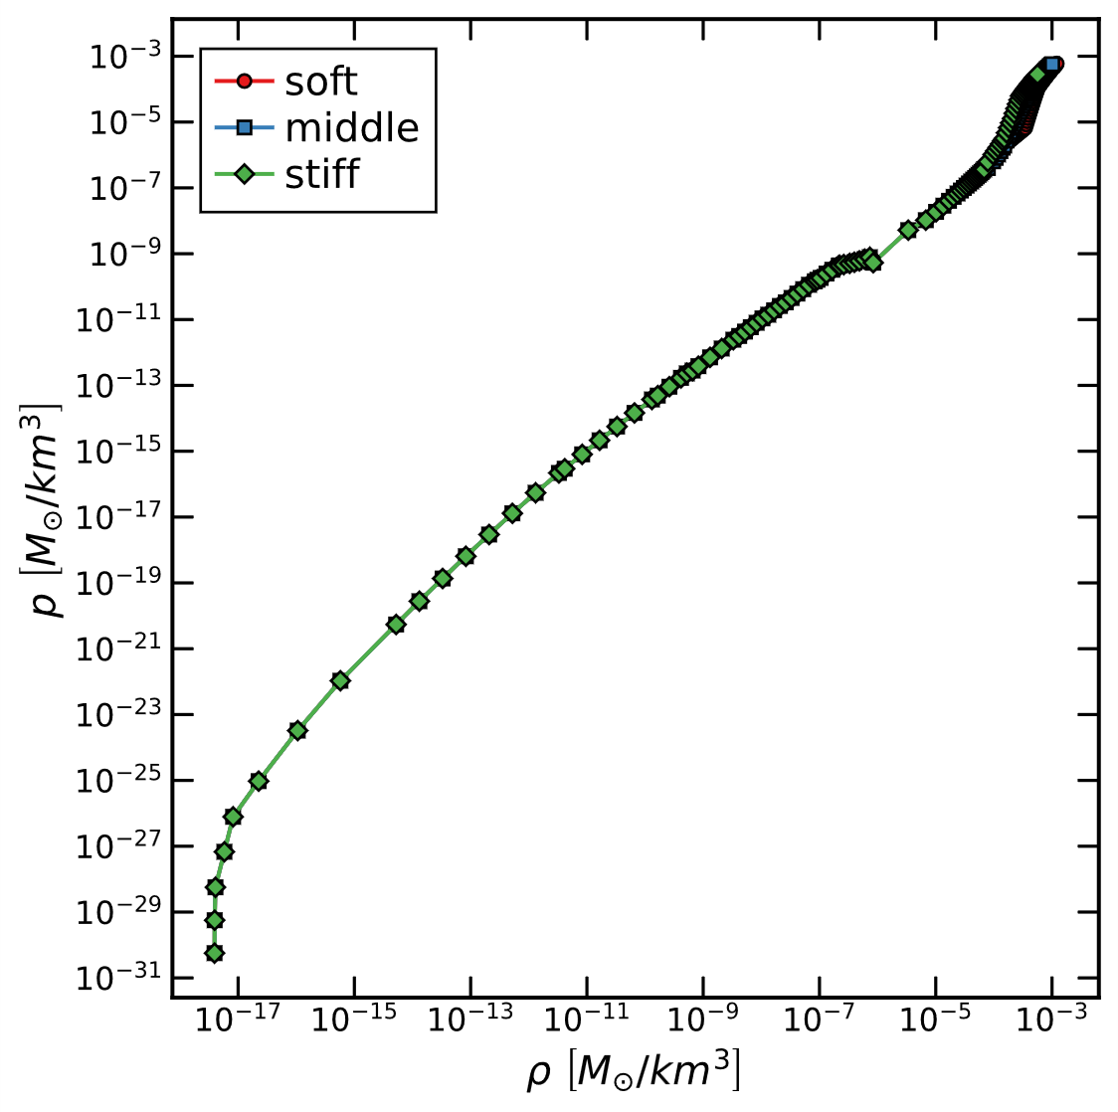
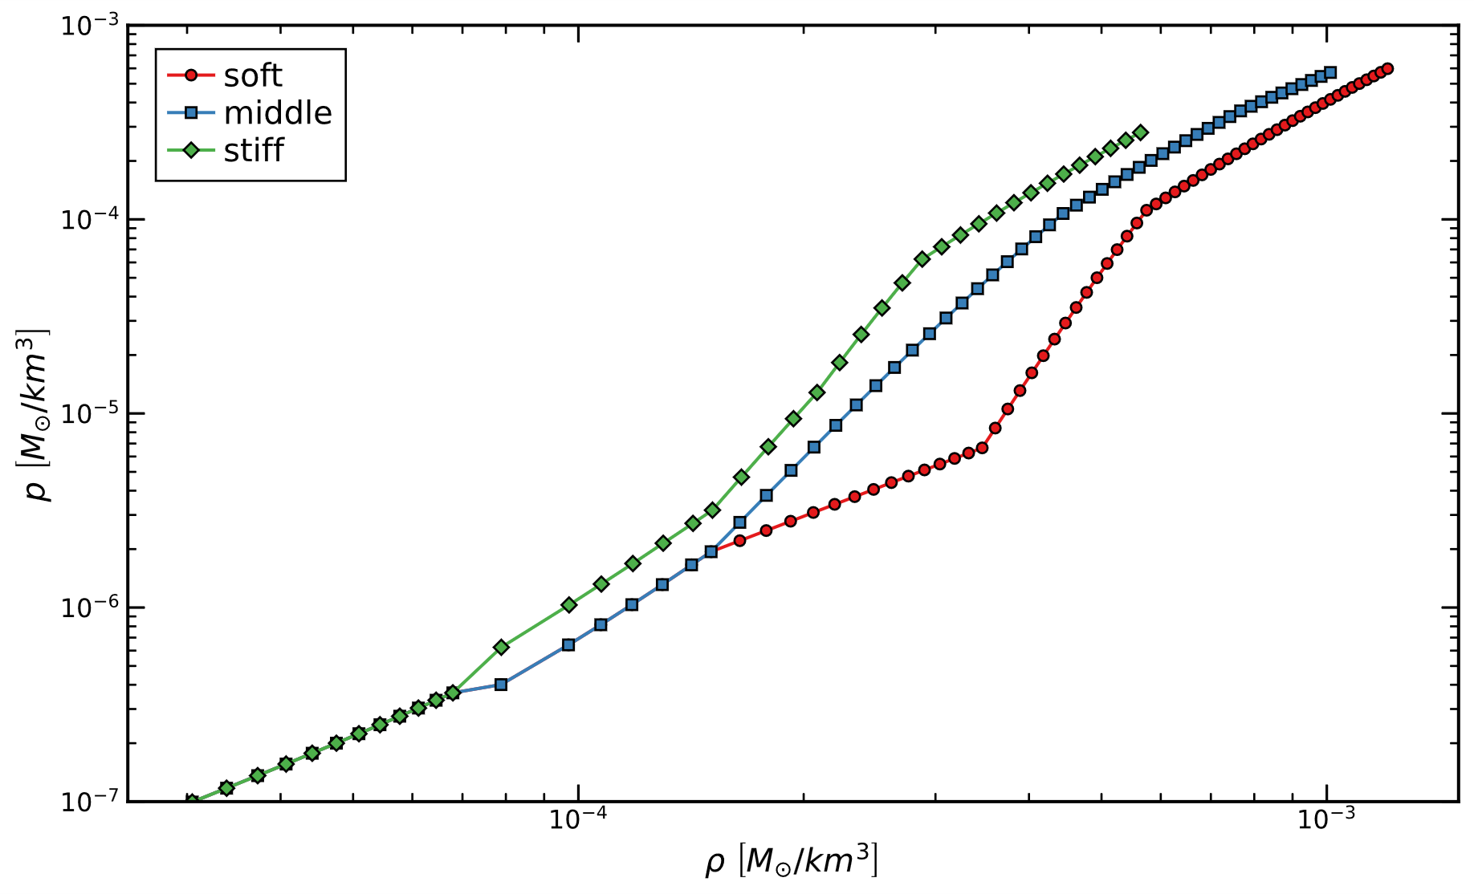
Equations of state: NS
Hebeler et al. (2013): Calculated via Chiral effective field theory.

Slide 10
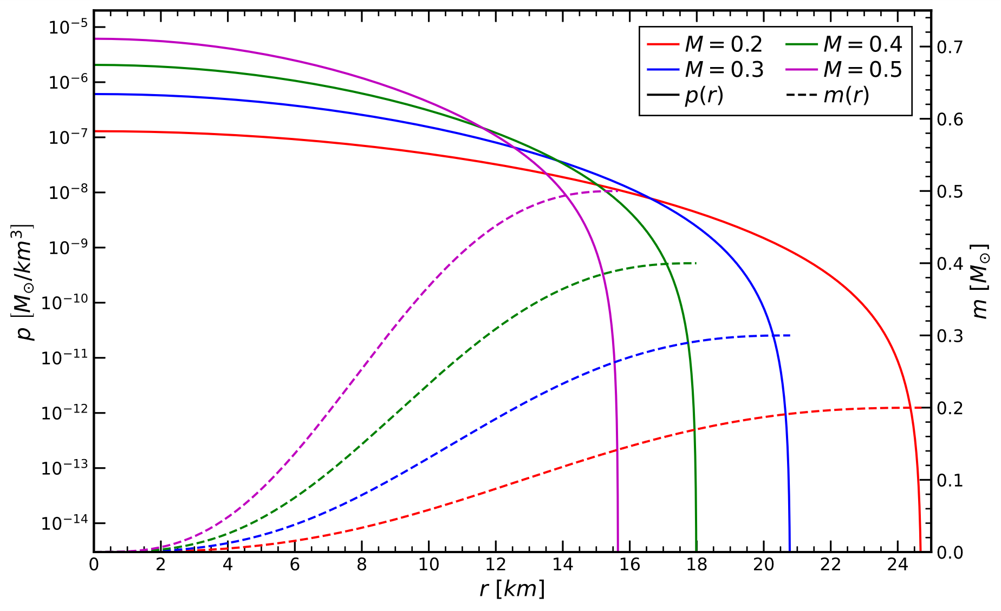
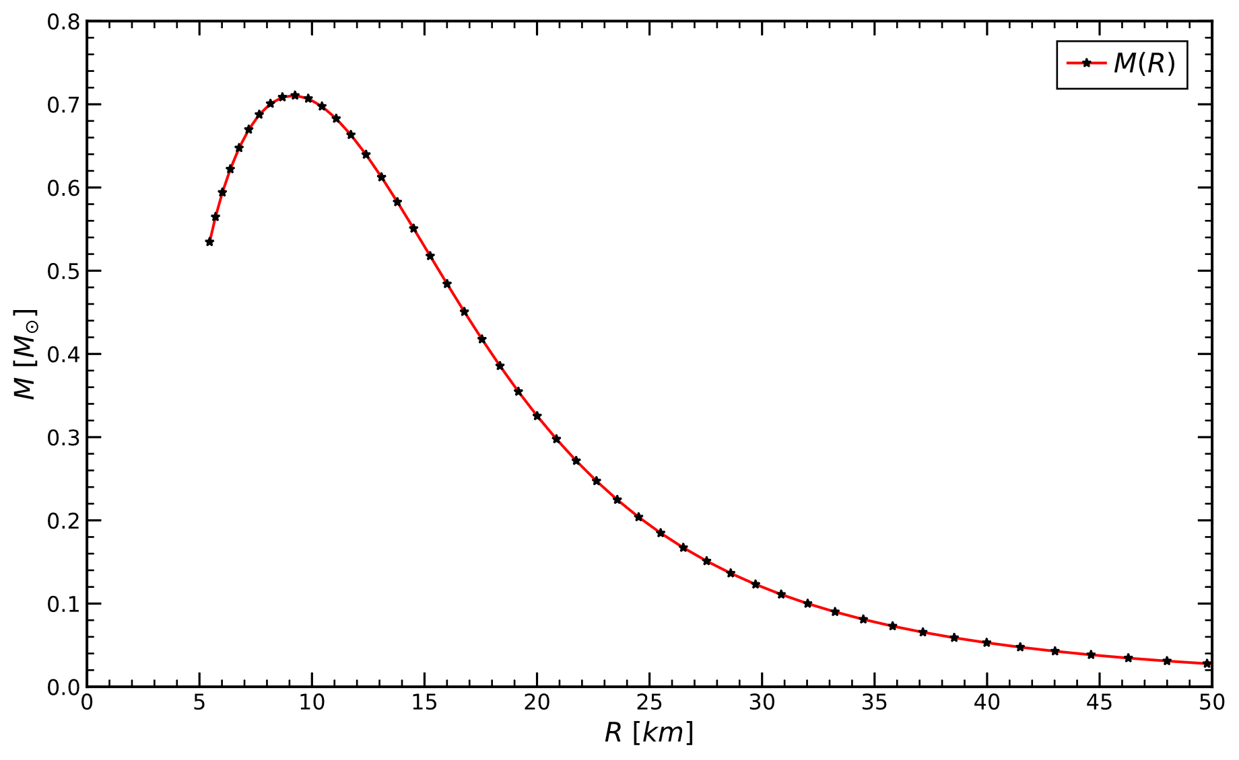
Hydrostatic solutions: Fermi Gas

Slide 11
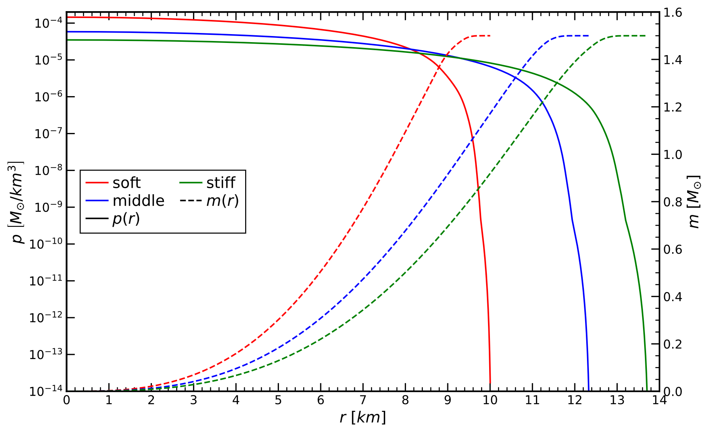
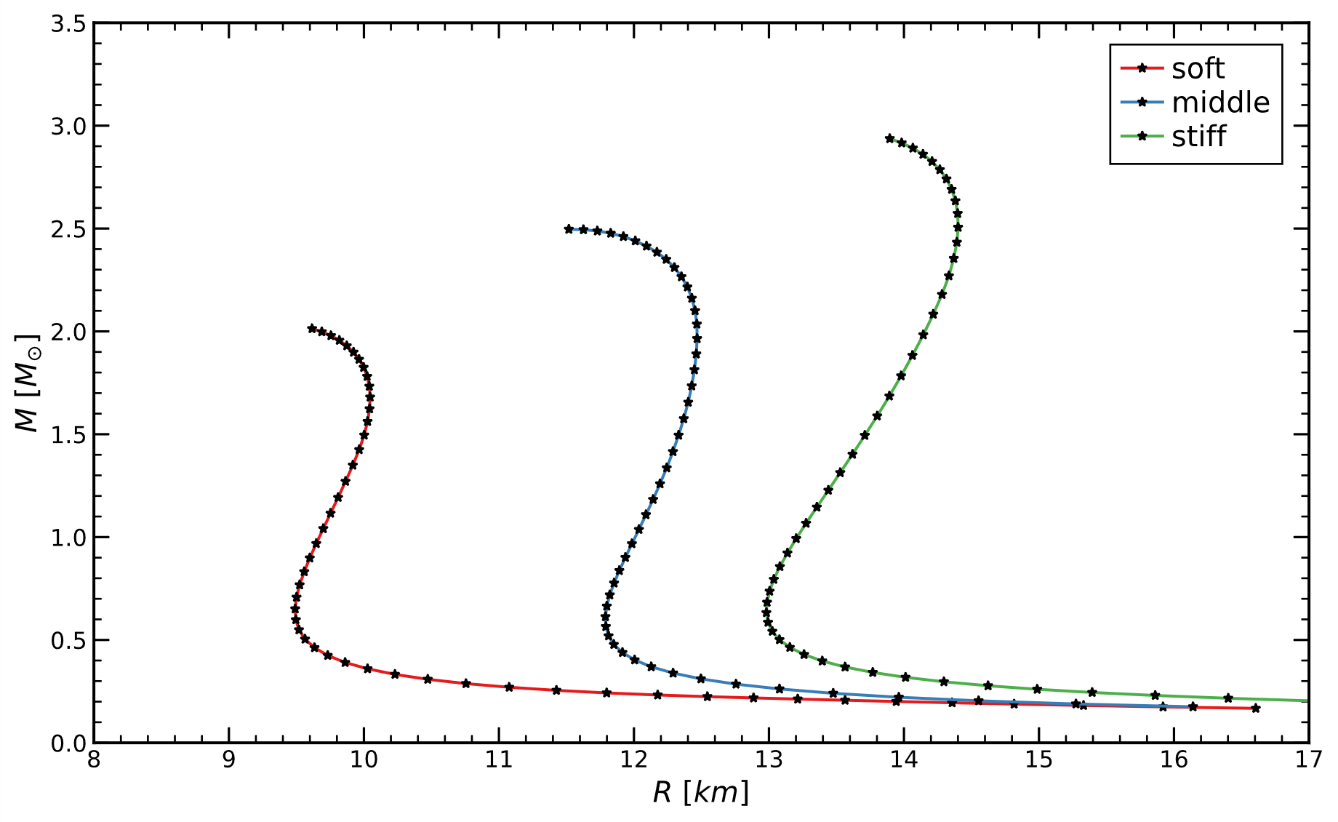
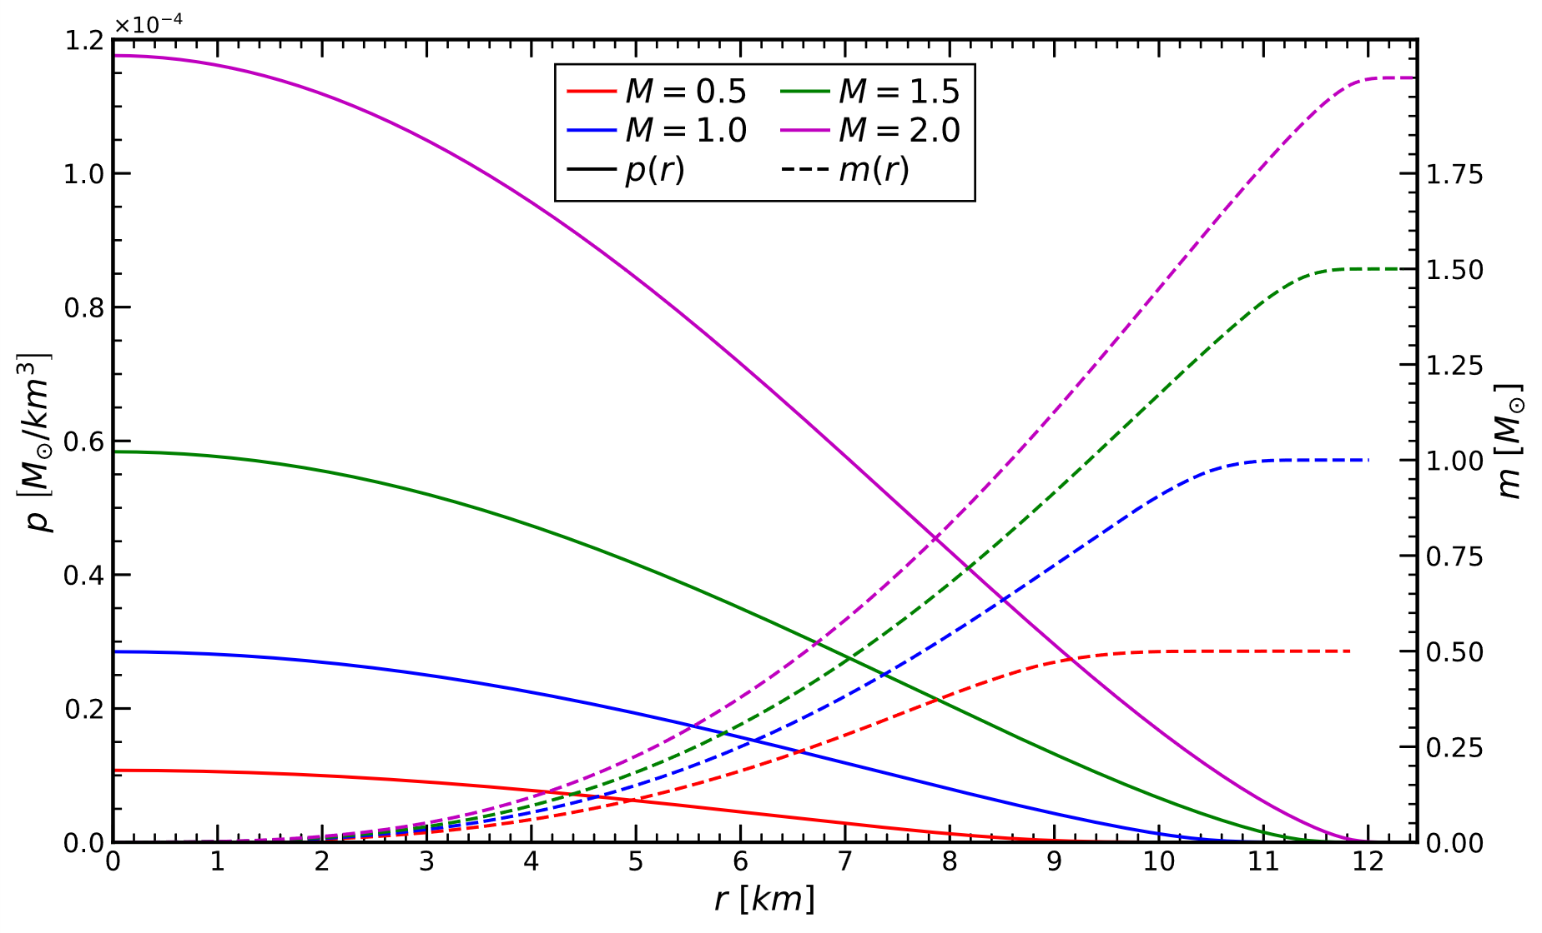
Hydrostatic solutions: NS

Slide 12
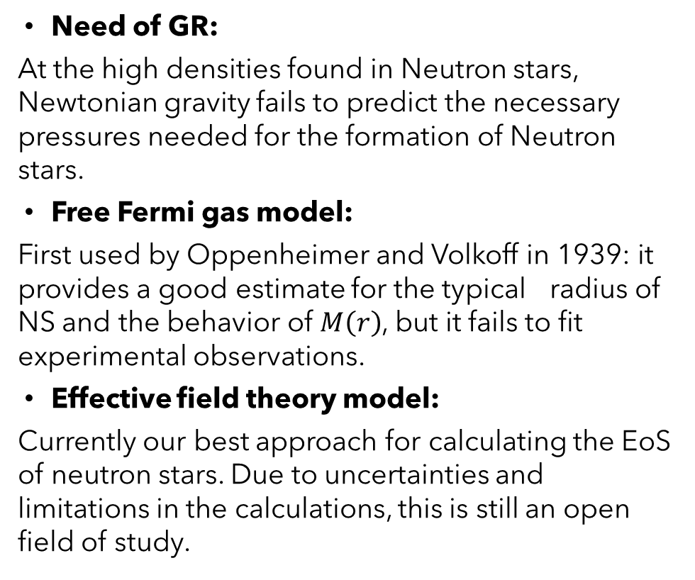
Conclusions
Need of GR:
At the high densities found in Neutron stars, Newtonian gravity fails to predict the necessary pressures needed for the formation of Neutron stars.
Free Fermi gas model:
First used by Oppenheimer and Volkoff in 1939: it provides a good estimate for the typical radius of NS and the behavior of $M\left(r\right)$, but it fails to fit experimental observations.
Effective field theory model:
Currently our best approach for calculating the EoS of neutron stars. Due to uncertainties and limitations in the calculations, this is still an open field of study.

